Slide 1
Python Project On
Text to Speech & Speech to Text Converter
Submitted to : Sushil Narang Sir
Submitted by :
Shivashish Bhunia – 2110993833
Sayan Bhandari - 2110993831
CSE AI G2

Slide 2
Text To Speech
Introduction
Text to speech is a process to convert any text into voice. Text to speech project takes words on digital devices and convert them into audio with a button click or finger touch. Text to speech python project is very helpful for people who are struggling with reading. The objective of this project is to convert the text into voice with the click of a button. This part is developed using Tkinter library, pyttsx3 and os module.

Slide 3
Speech To Text
Introduction
Speech recognition is useful in various appliances around us like Google Assistant, Alexa, Cortana etc.. This project will recognize the speech of the user and print it on the Tkinter window. This part is developed using Tkinter library, speech_recognition and os module.

Slide 4
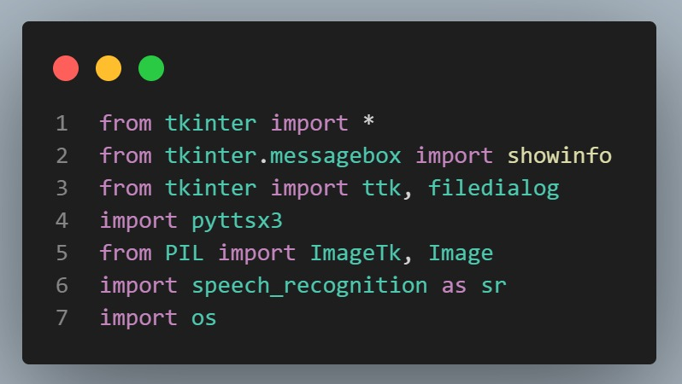
Project Prerequisites
Tkinter is a standard GUI Python library that is one of the fastest and easiest ways to build GUI applications.
pyttsx3 is a text-to-speech conversion library in Python. Unlike alternative libraries, it works offline and is compatible with both Python 2 & 3.
Speech_recognition is a module in python that helps to record the speech of a person.
os is a pre-installed module.
To install the required libraries, we will use the pip command in the terminal.
pip install tkinter
pip install pyttsx3
pip install speech_recognition

Slide 5
Some Features in our Project
Converting Text to Speech & Speech to Text.
We can change Male/Female voices.
We can change the speed of the speech.
We can change the volume of the speech.
We can mute the speech.
We can also download the converted speech into male/female voices.

Slide 6
These are the basic steps :
Importing the modules
Define functions for TTS and STT
Designing TTS and STT windows
Defining and designing the main window

Slide 7
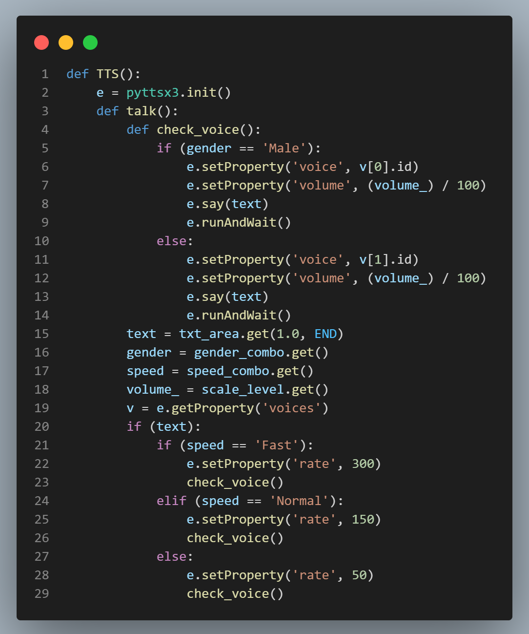
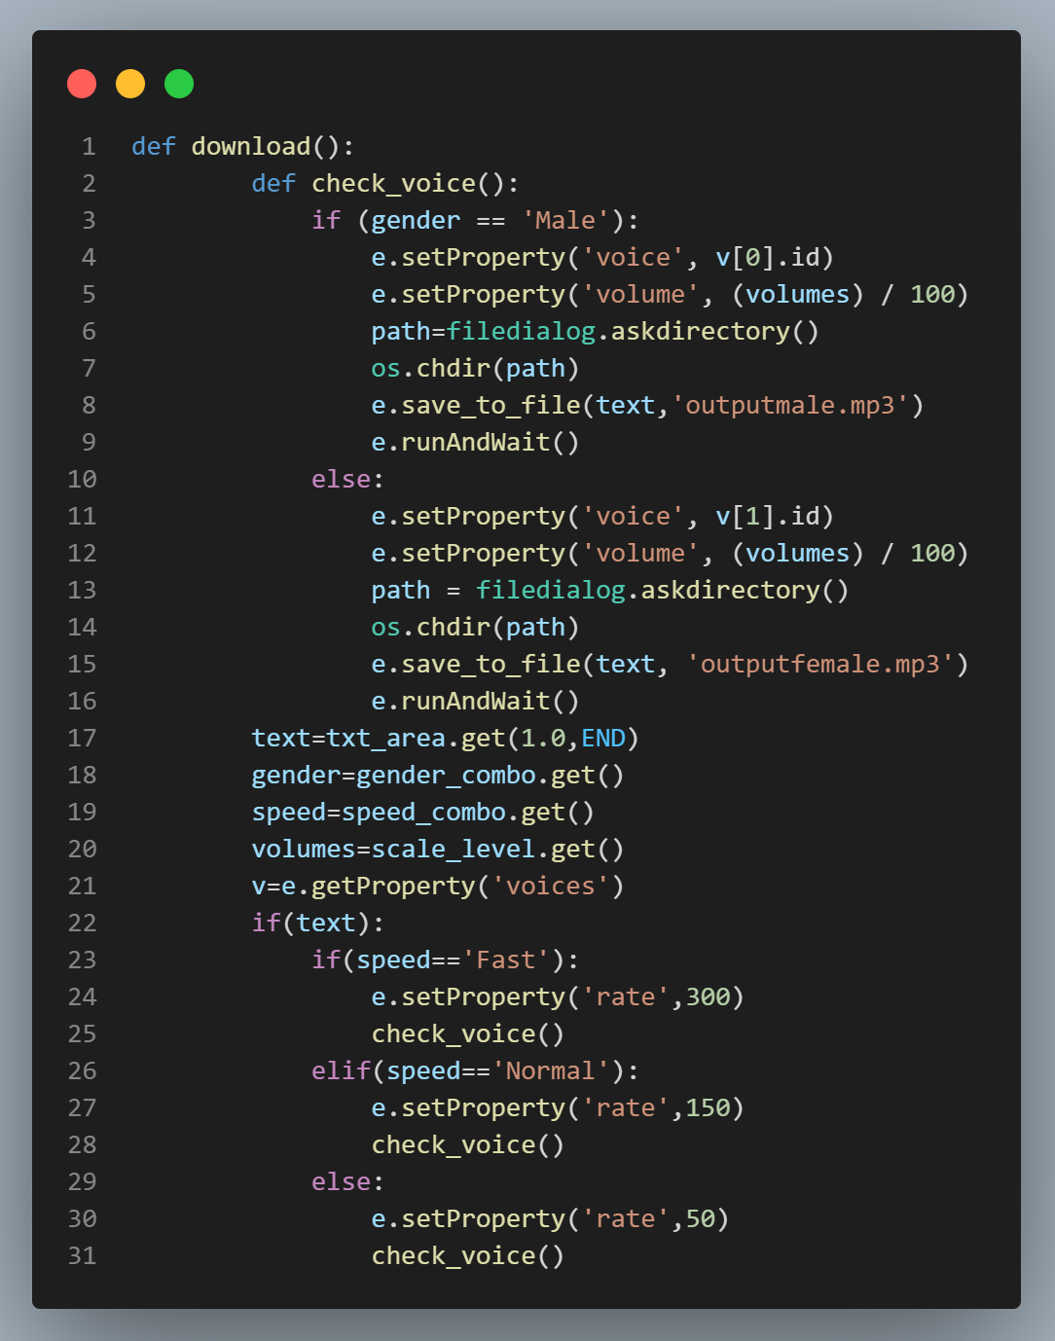
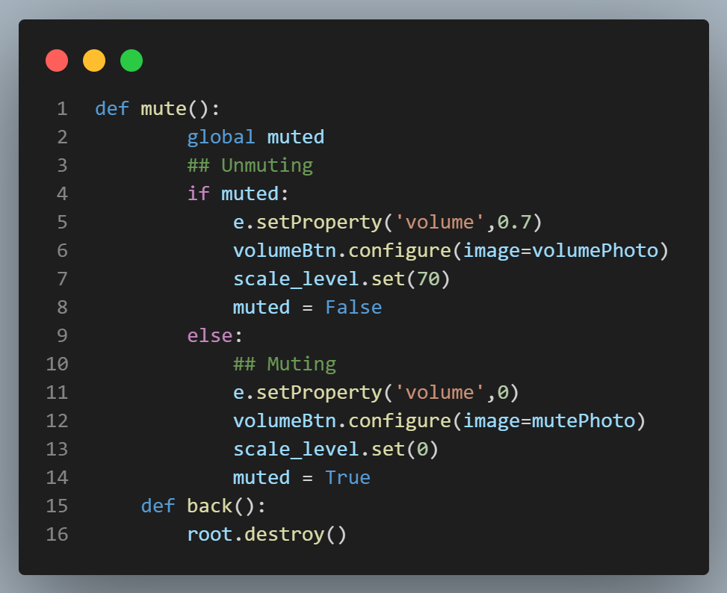
Defining TEXT-TO-SPEECH
Importing the modules
Defining Mute Function
Defining Play Function
Defining Save Function

Slide 8
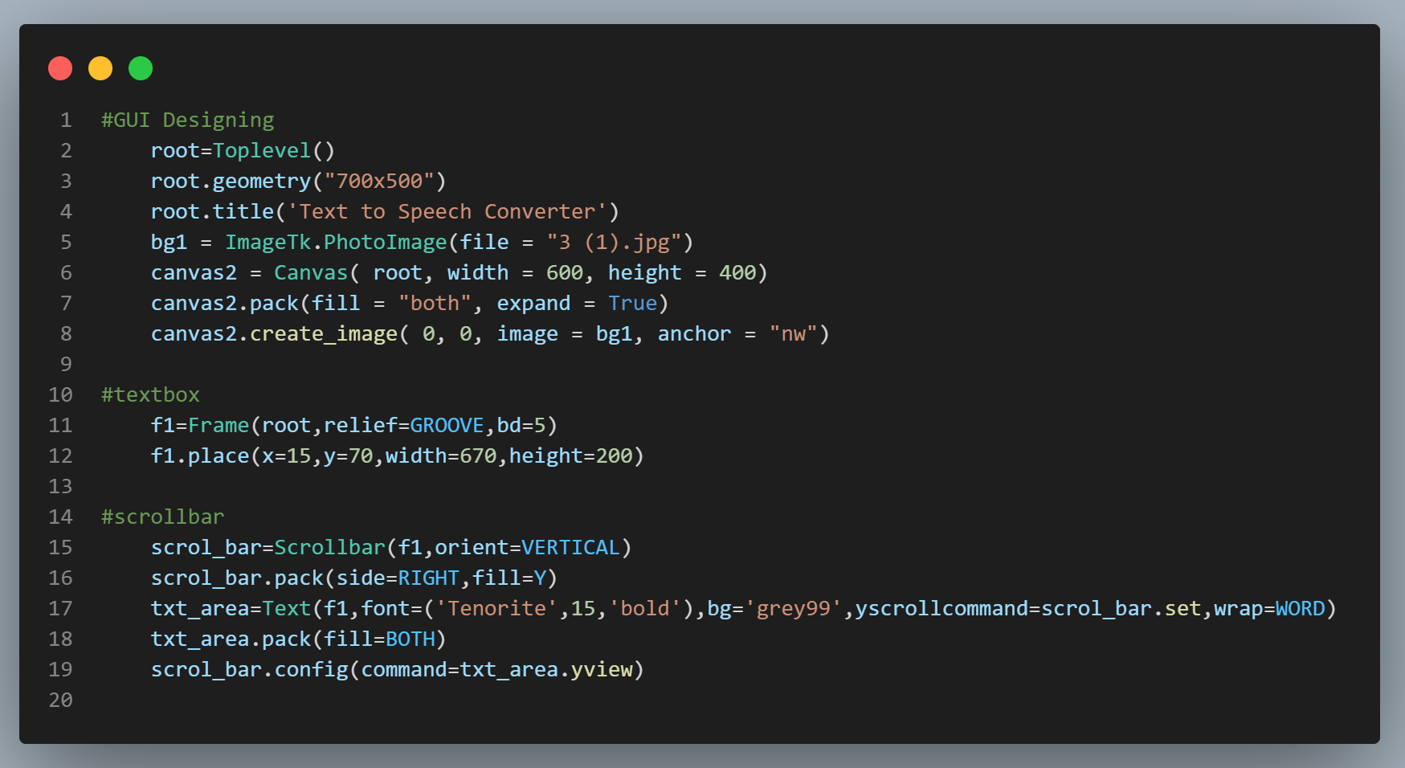
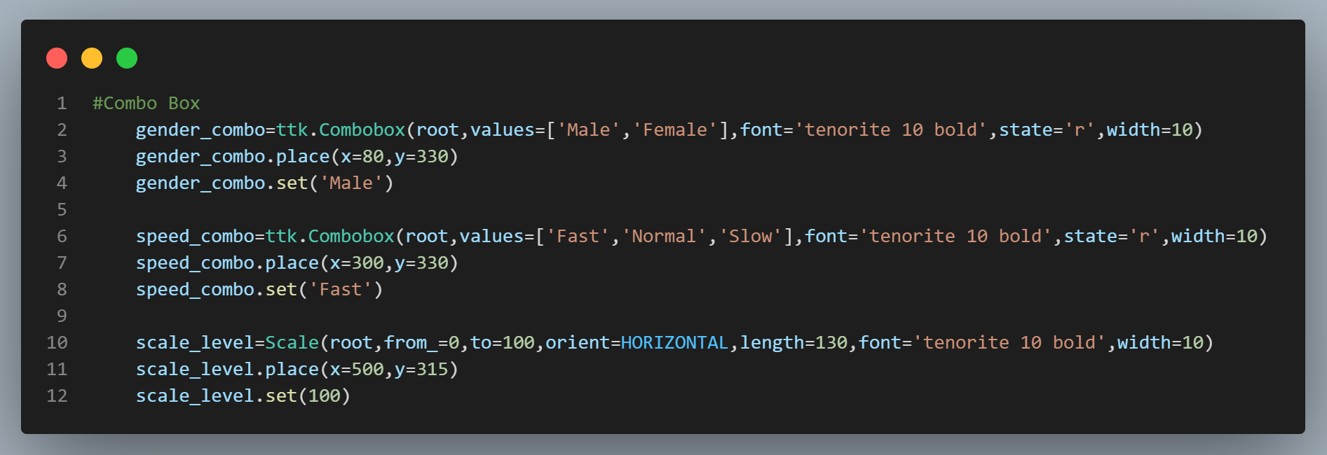
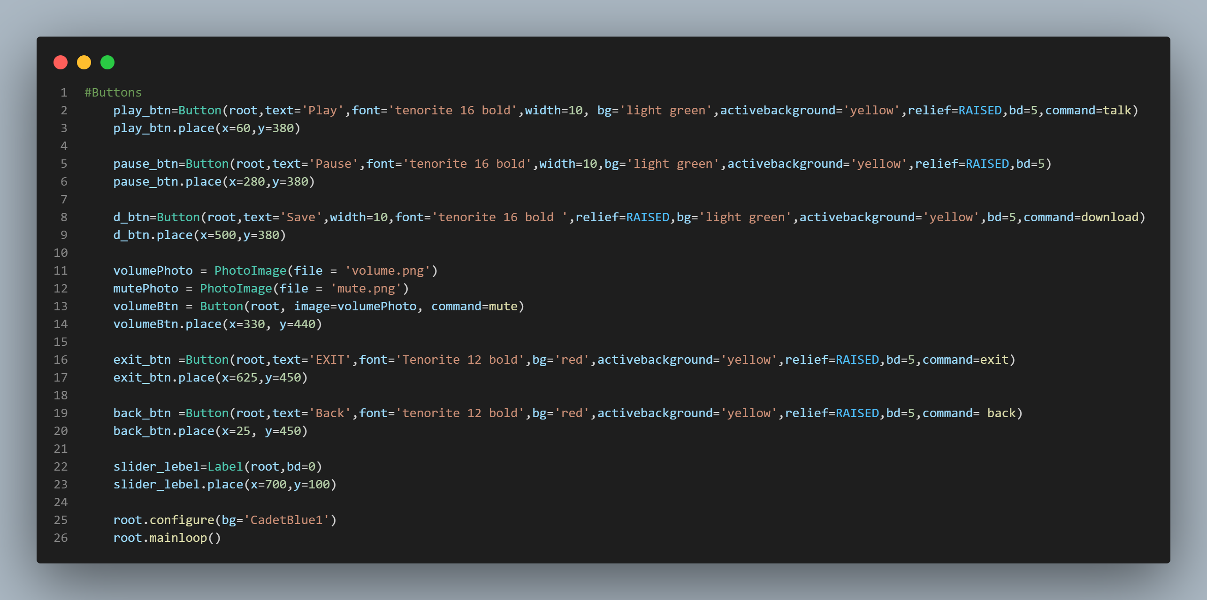
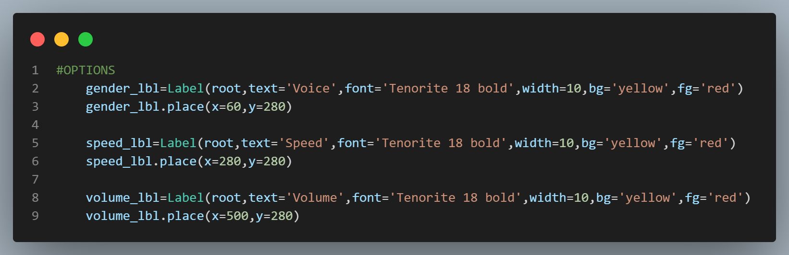
Designing TEXT-TO-SPEECH GUI

Slide 9
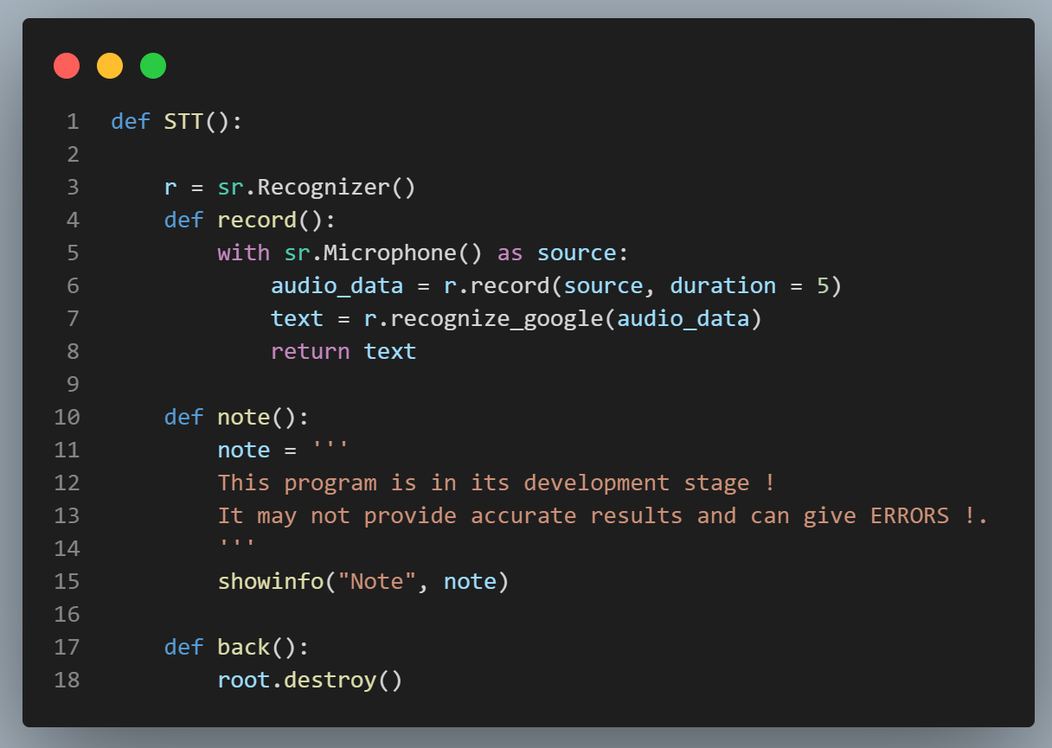
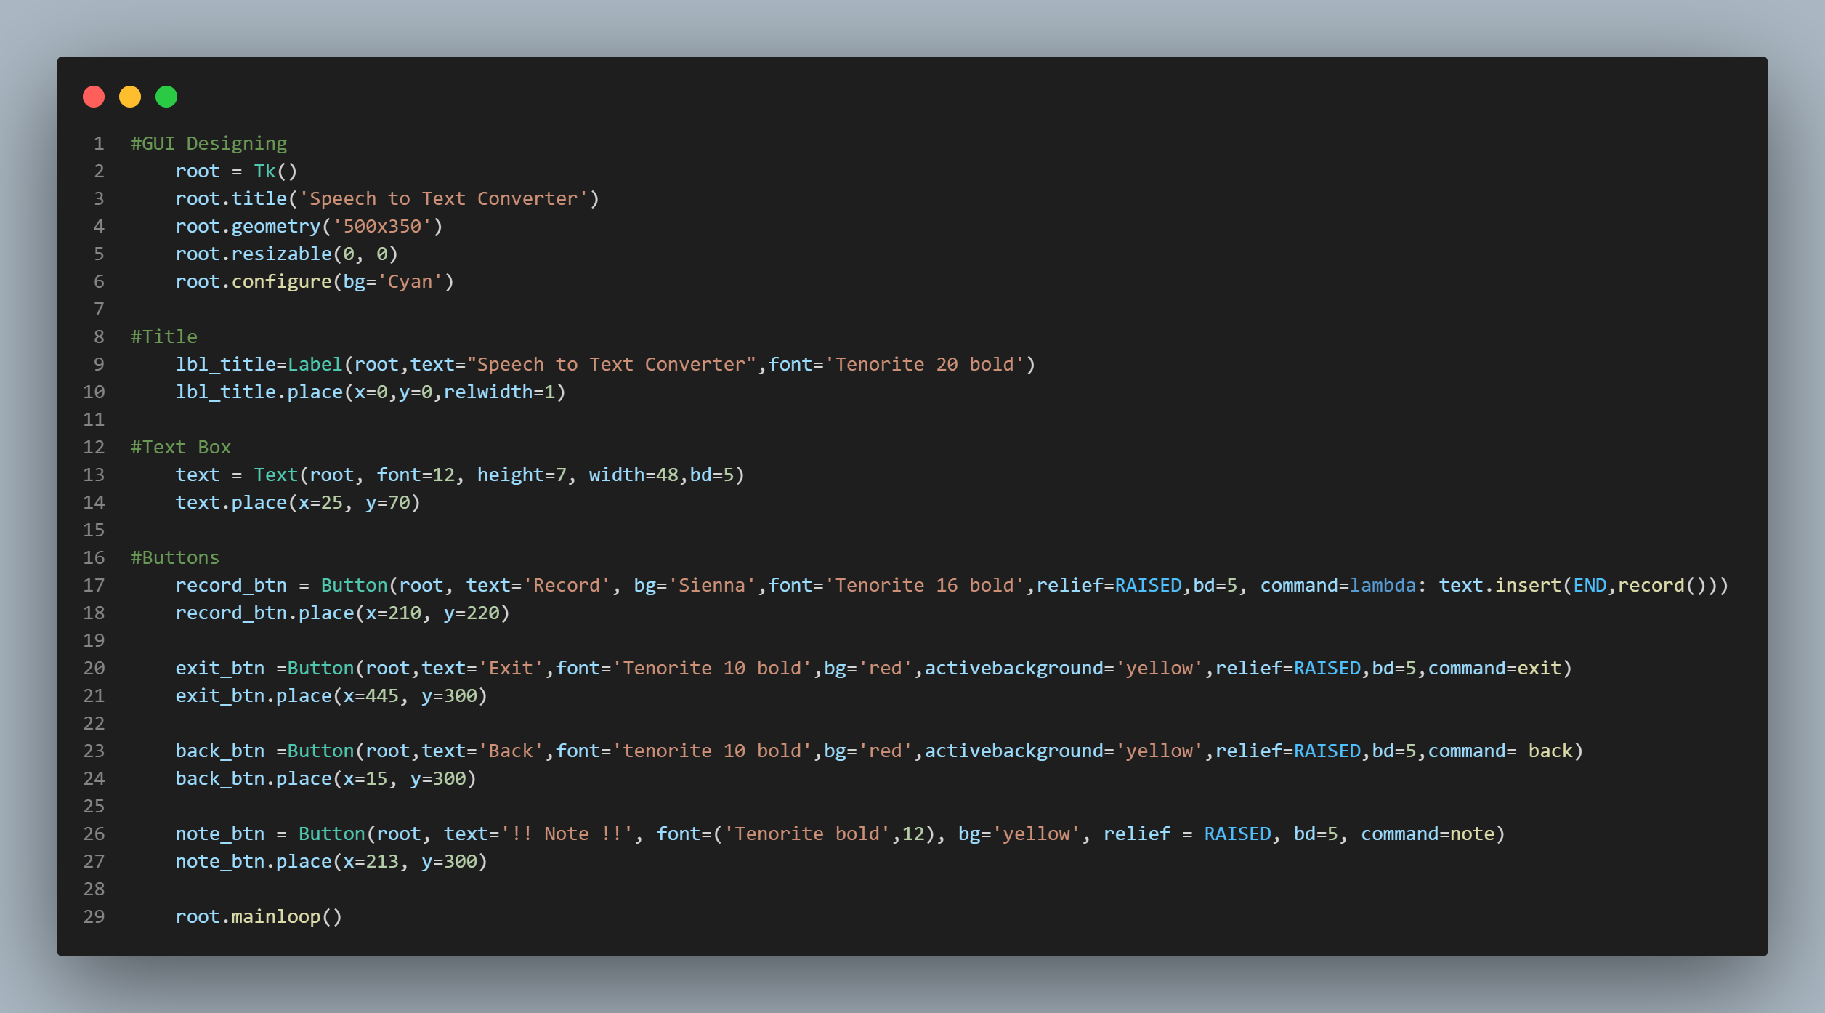
Defining SPEECH-TO-TEXT
Designing SPEECH-TO-TEXT

Slide 10
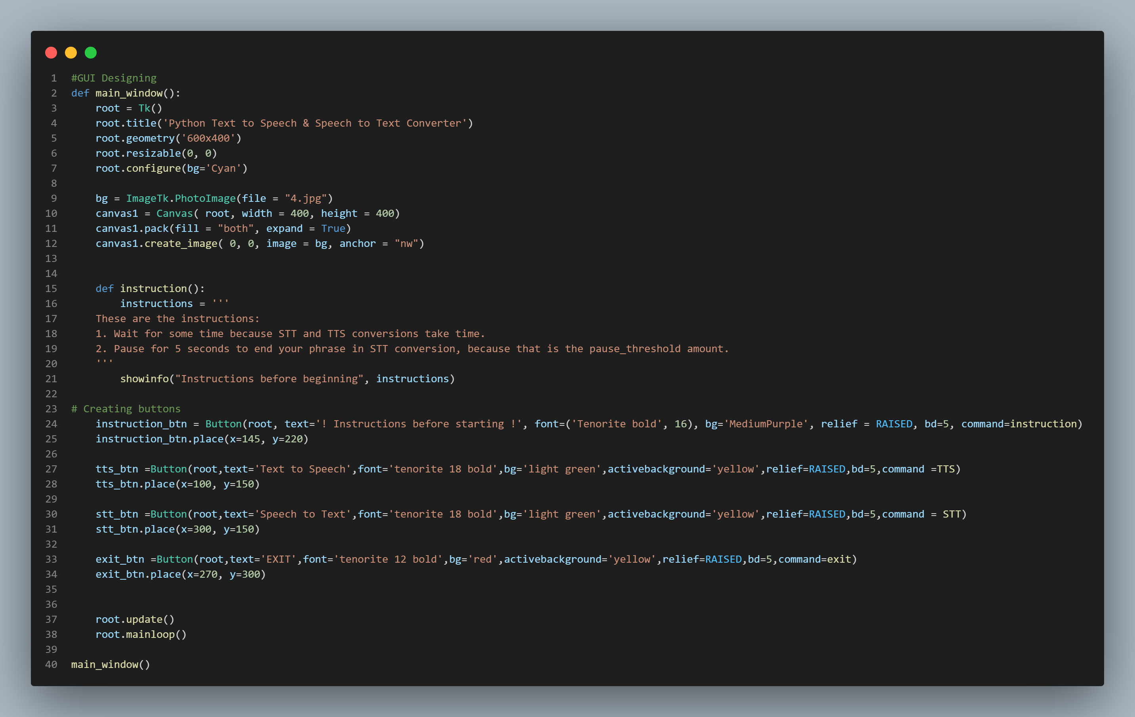
Main Window and GUI

Slide 11
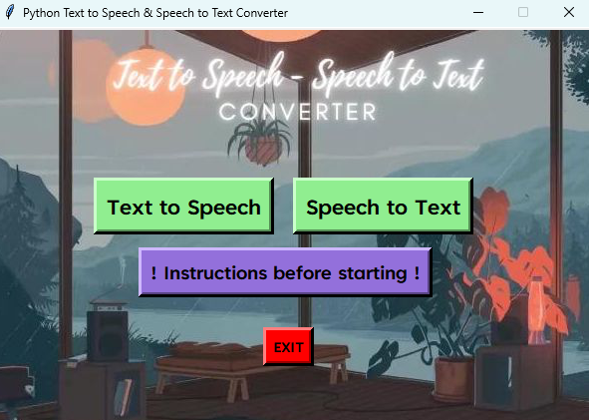
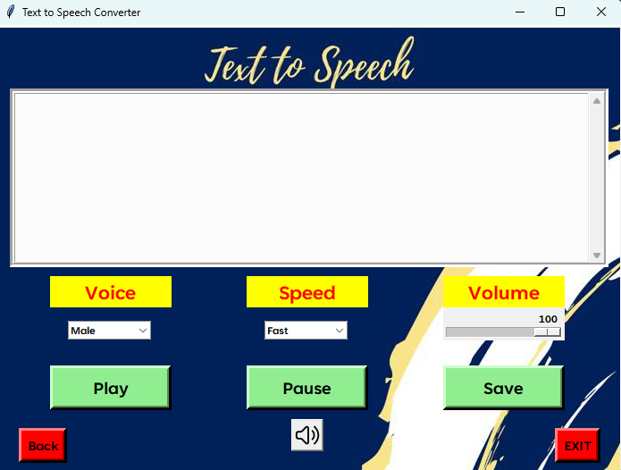
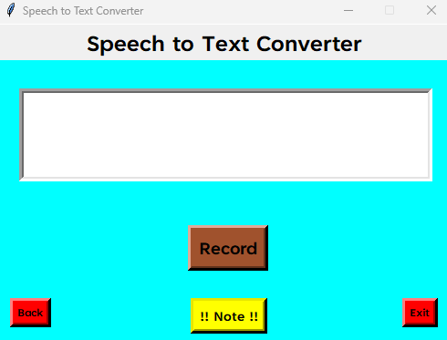
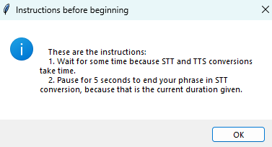
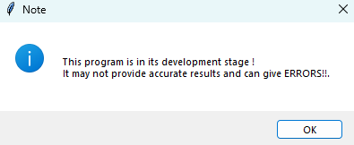
Output Windows

Slide 12
Thank You !

